Slide 1
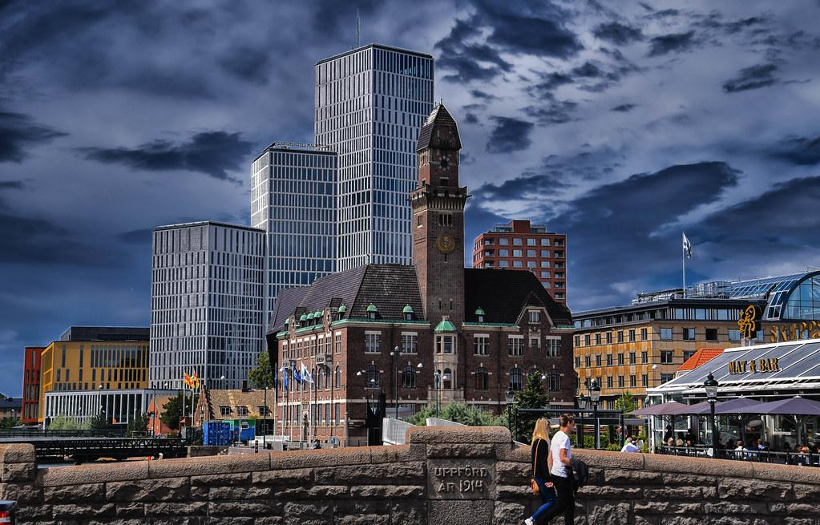
Best4ent C1 joint Staff Training Activity
(Malmo, Lund, Sweden)
This Photo by Unknown Author is licensed under CC BY-SA
This Photo by Unknown Author is licensed under CC BY

Slide 2
Best4ent -Best practices over the Europe for Education to Entrepreneurship Erasmus+ KA2 Project n. 2020-1-IT01-KA202-008516 SHORT-TERM JOINT STAFF TRAINING EVENT, 17-19 October 2022 –LUND/Malmo (SWEDEN) HOSTING ORGANIZATION: Mobilizing Expertise Venue Place: Axel Dannielssons väg meeting room. Malmo 21574
PROGRAMME OF THE STAFF TRAINING
Sunday 16th of October 2022: Arrival day
Monday 17th of October 2022 | 9:30 – 11:00 | Introduction to the training & presentation of the participants; ice breaking games delivered by the hosting partner
 | 11:00 – 11:30 | Coffe break
 | 11:30 – 13:00 | best practices by Polaris
 | 13:00 – 14:30 | Lunch break
 | 14:30 – 16:00 | Visit to Redi School
Date | Time | Activity
Tuesday 18th of October 2022 | 09:00 – 9:30 | Ideon Breakfast Lund
 | 9:30 – 11:00 | Best practices by Mobilizing Expertise
 | 11:00 – 12:30 | Best practices by Palizzi
 | 12:30 – 13:30 | Lunch break
 | 13:30 – 16:00 | Visit to an innovative business in Lund
 | 16:00 – 16:30 | Tea break
 | 16:30 – 18:00 | Best practices by Gyulai
Wednesd ay 19th of October | 09:30 – 11:00 | Visit to South Plains Brewing Company, Sperlingsgatan 10A, 212 22 Malmö
 | 11:00 – 11:30 | Coffee Break
 | 11:30 – 13:00 | Visit to Level Up Malmo Per Albin Hanssons Väg 40, 214 32 Malmö
 | 13:00 – 14:30 | Lunch break
 | 14:30 – 16:00 | Best practices by Aidejoven
 | 16:00 – 16:30 | Tea break
 | 16:30 – 18:00 | Discussion on the contents and materials to be collected in the Handbook, and on how this tool should be used during the pilot courses to be organized at local level. Exchanges on how the Handbook can be integrated into the curriculum and teaching approaches of the project partners. Evaluation of the training course & release of the certificates of attendance
 | 18:00 – 20:00 | Farewell dinner
Thursday 20th of October 2022: departure day

Slide 3
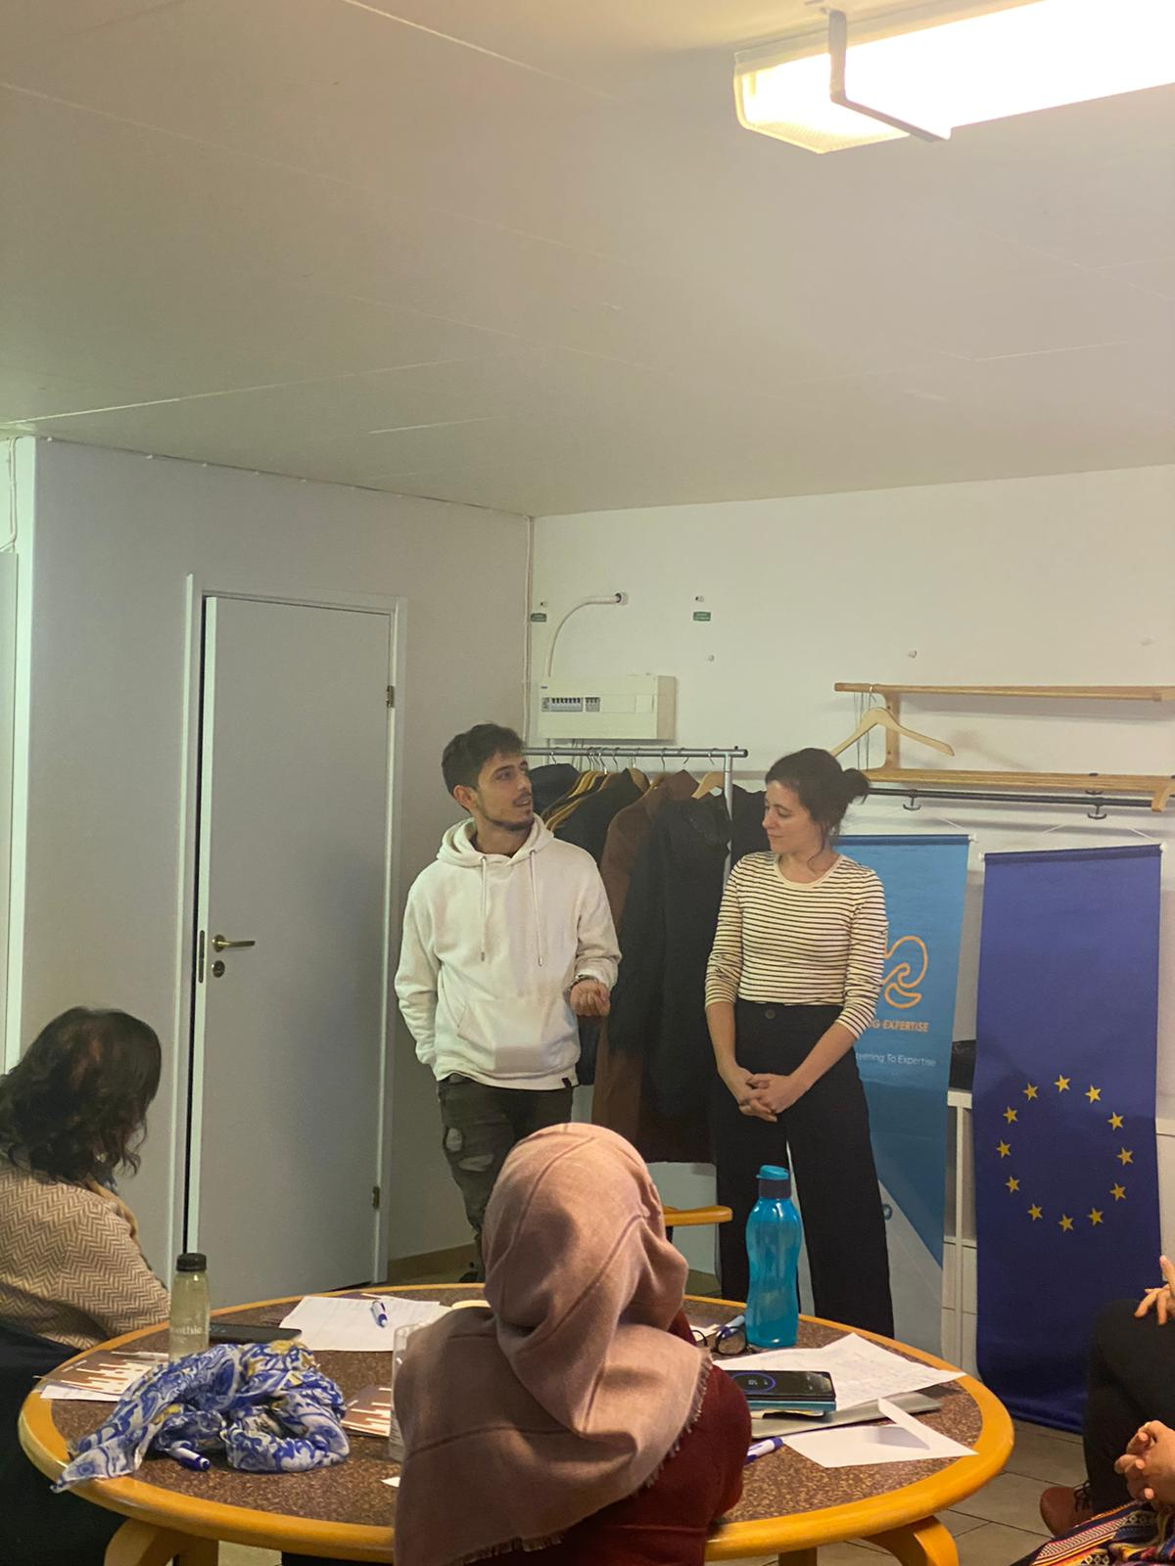
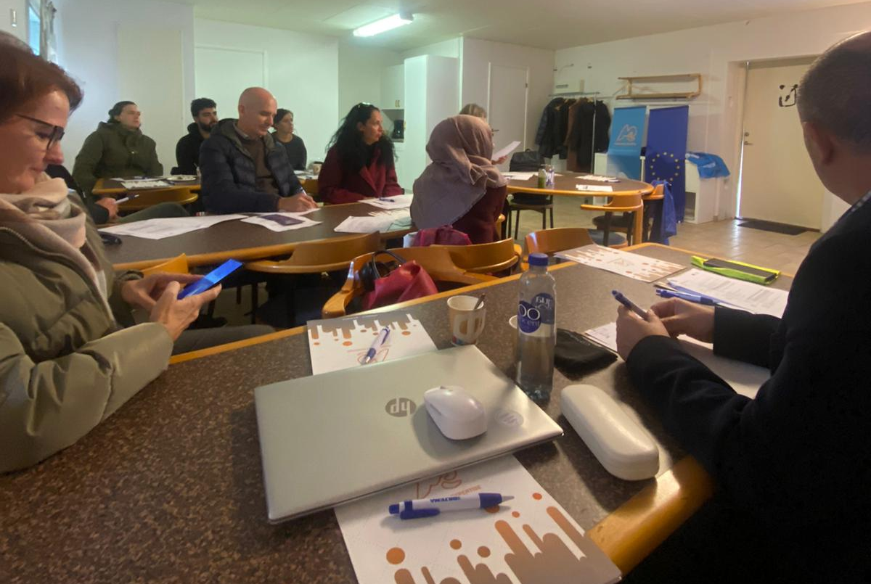
Presentation of Best Practice

Slide 4
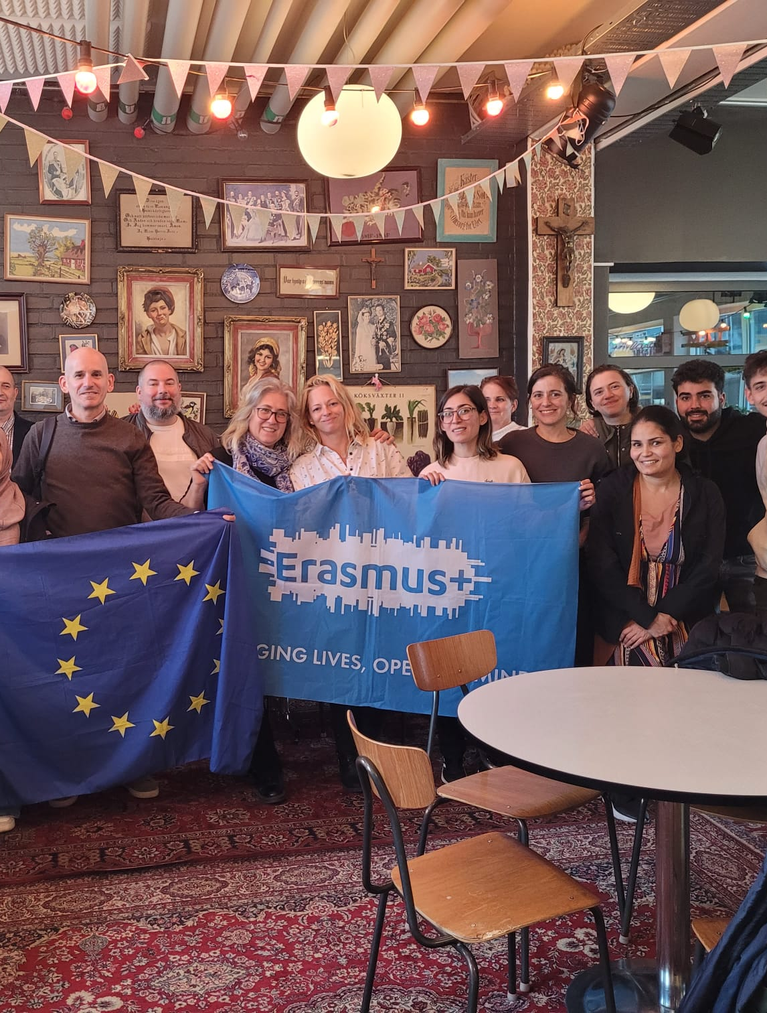
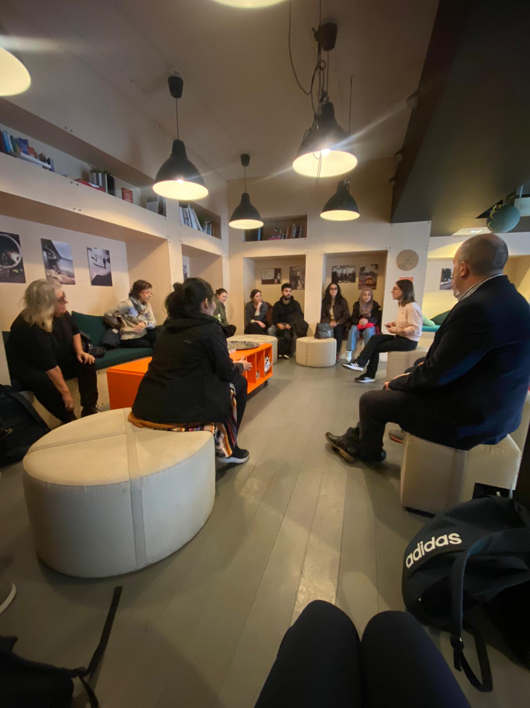
Visit of Redi Digital School

Slide 5
Redi Digital School
ReDI School is a non-profit tech school for women with migrant- and refugee background, offering a free program, including IT and tech courses on several levels. Our focus is to create digital empowerment by supporting women in getting access to digital skills and a social & professional network in Sweden. We also work for more diversity and inclusion in the Swedish labor market, especially in the tech sector We believe that newcomers are a great opportunity for society and we are here to give them a helping hand to make use of their potential.

Slide 6
Feedback For Redi School
They were happy to host us and share their business
It was a great experience learning about the organizations and schools
It was great promotion
It served to strengthen ties between them and the host organization.
This then lead to more opportunities between them and the host organization Mobilizing Expertise.

Slide 7
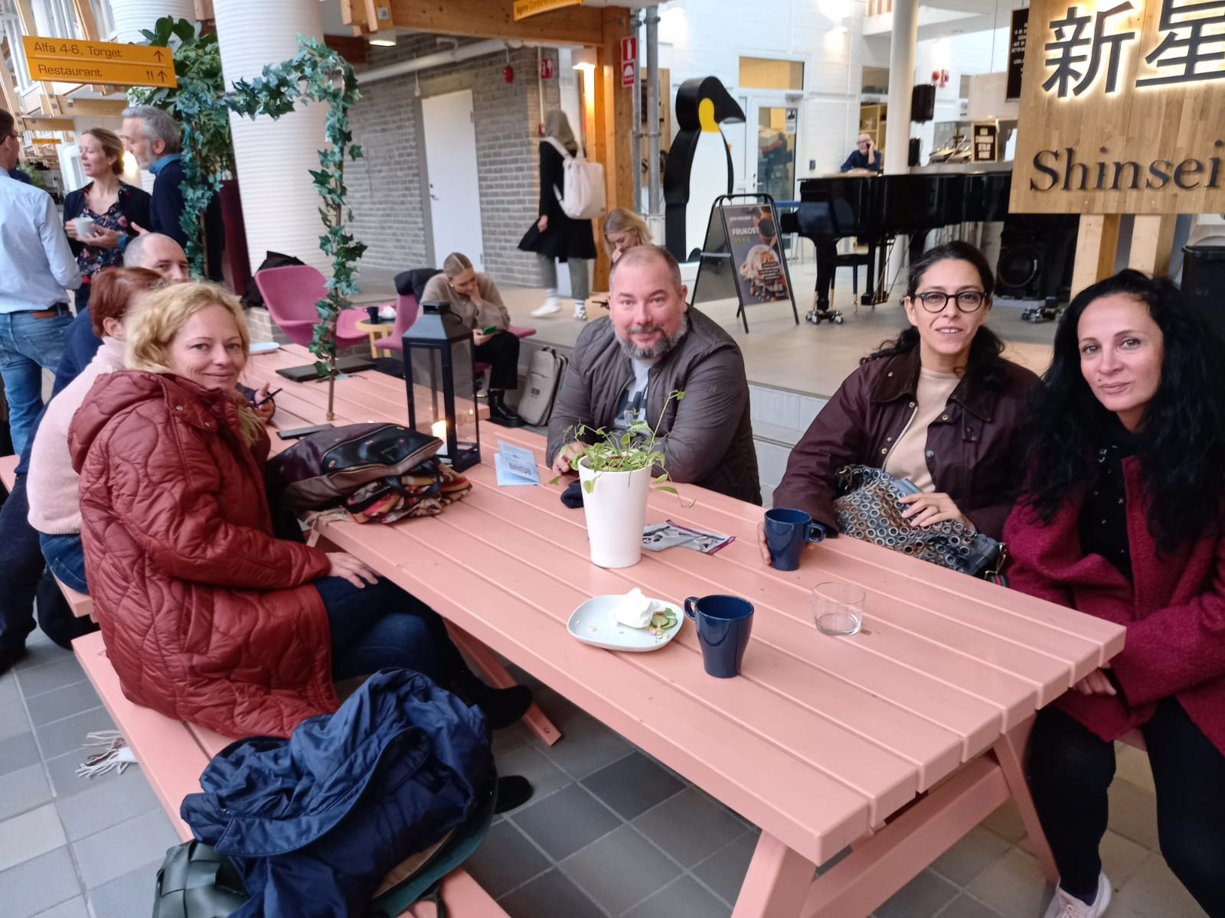
Ideon Breakfast

Slide 8
Ideon Breakfast
Ideon Breakfast at Ideon Science Park (Agora building, Scheelevägen 15) is a great way to meet new connections and to grow your network. No cost, no registration needed. It is also a great way to introduce your business.

Slide 9
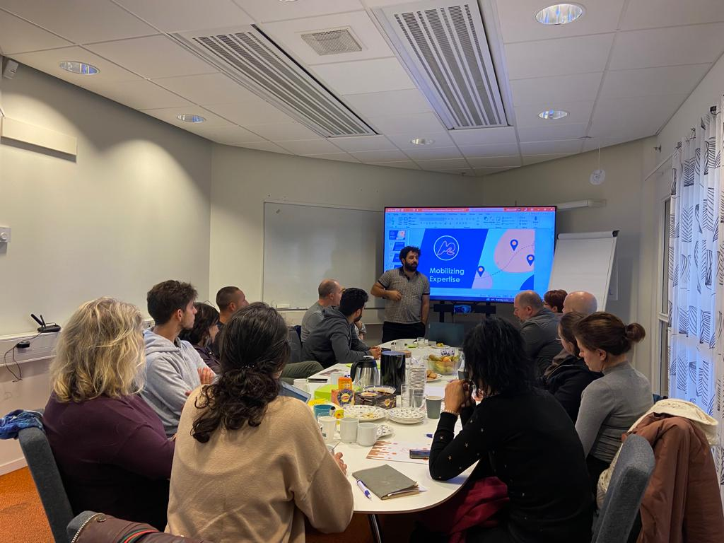
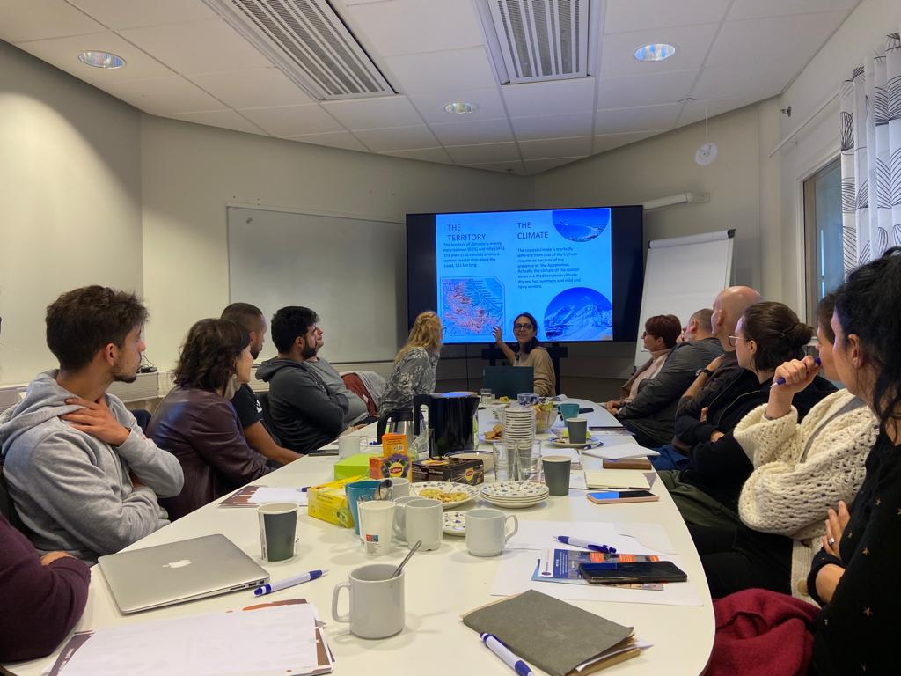
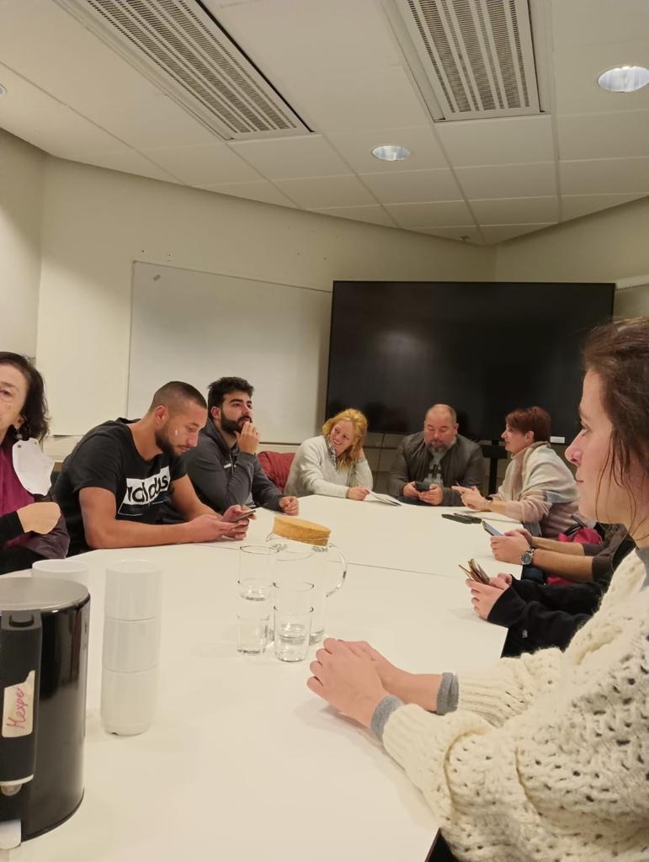
Presentations of Best Practices

Slide 10
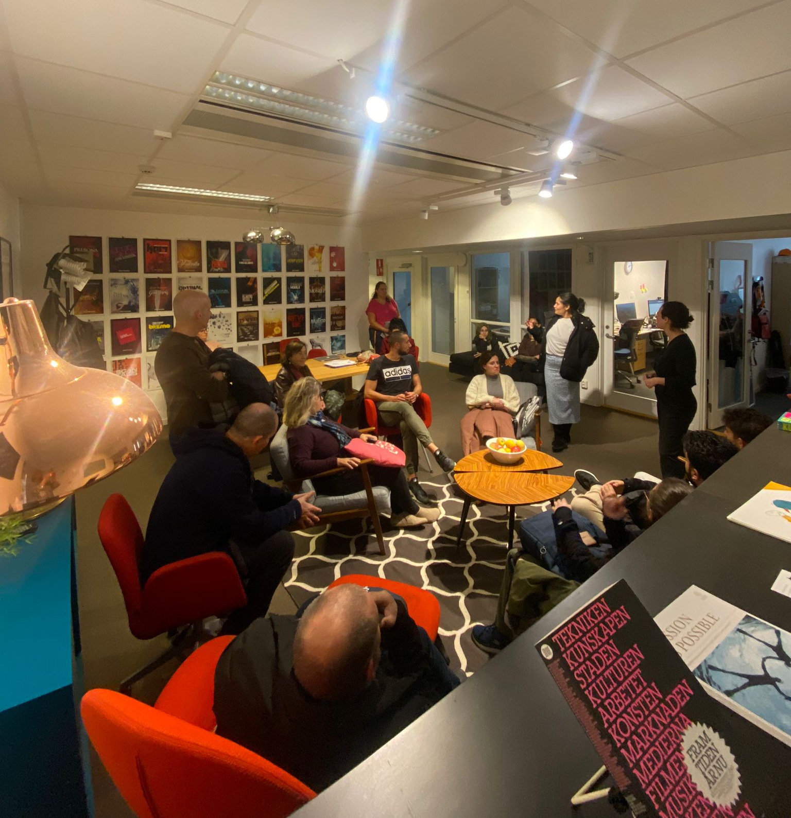
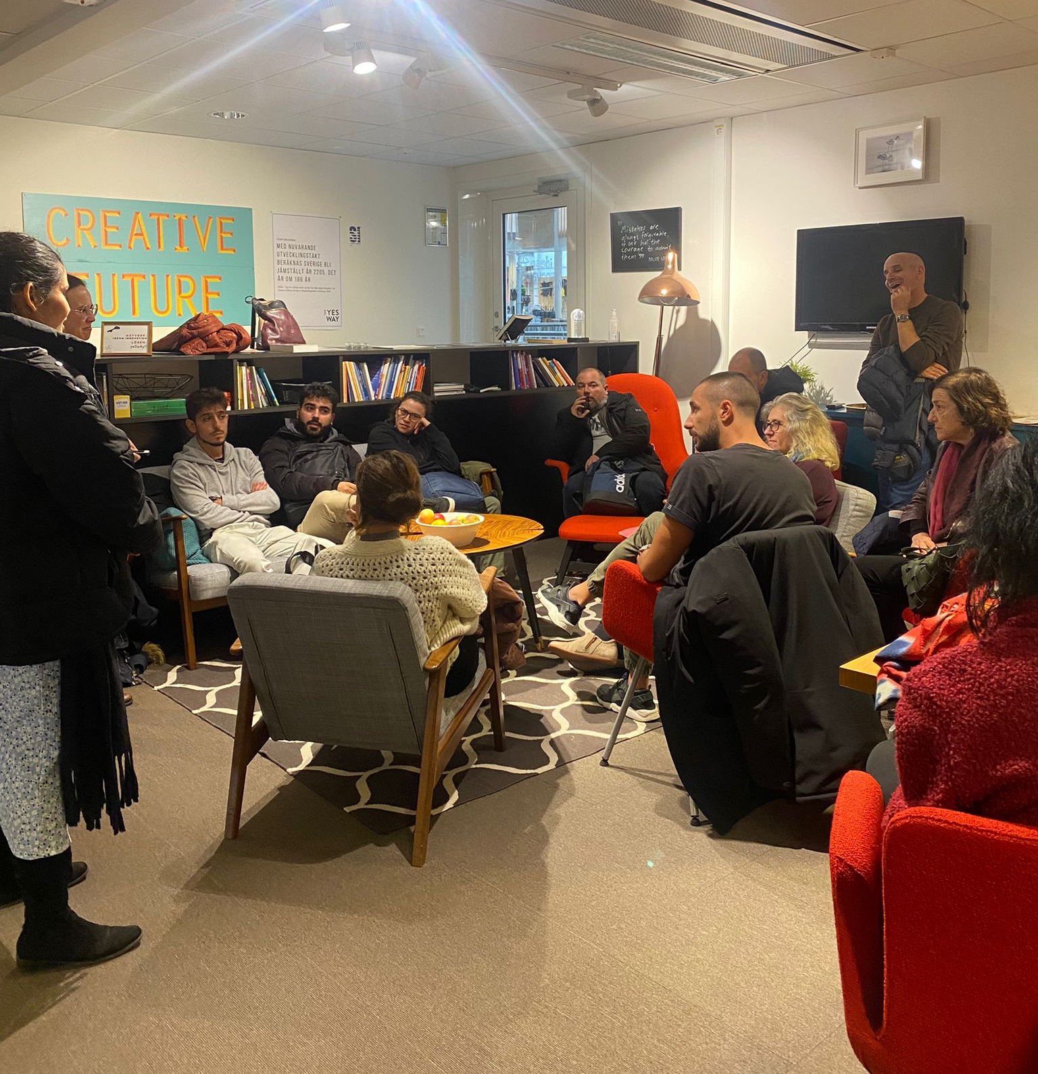
Visit to Lund Ideon Innovation

Slide 11
Ideon Innovation
Ideon Innovation is an incubator that develops entrepreneurs, ideas and companies through well-chosen, value-creating activities and supportive resources. With experienced business coaching and broad collaboration.
Ideon Innovation is a greenhouse for new ideas and a coworking space that help startups to grow to their dreams. They are located in the middle of the Ideon Science Park in Lund – a nurturing environment for innovation and collaboration.
It is a place for people and a place for passion. They firmly believe that together with us you can achieve great things!

Slide 12
Visit to South Plains Brewing Factory

Slide 13
South Plains Brewing Factory
South Plains Brewing Company is a microbrewery located in Malmö, Sweden and aims to release high quality, hand-crafted artisan ales made only with the purest ingredients.To bring inspiration and innovation to craft beer in Sweden. These are the Fundamental Values we as an Organization Have.
Commitment to Sustainability
Community Oriented
Innovation & Exellency
South plains Brewery was founded by an entrepreneur by the name of Jeffrey Scott Brown.

Slide 14
Visit to Level Malmö

Slide 15
Level Malmö
LEVEL exists to bring your dreams to fruition and to put Malmö on the map as an international hub for positive global impact. Through strategic alliances, collaborative efforts, and custom business services, LEVEL is slated to be Malmö’s most powerful engine for international relations.

Slide 16
Feedback from Level Malmö
They were happy to host us and share their business.
We shared our Entrepreneurial practices
It was a great experience learning about the organizations and schools
It was great promotion
It served to strengthen ties between them and the host organization.

